Slide 1

Introduction to MPLAB IDE and LED Blinking
DAY 19
EMBEDDED SYSTEM DESIGN & IoT-Master Class

Slide 2
What You will learn Today?
Embedded system design using PIC
Introduction to MPLAB IDE
LED Blinking

Slide 3
Mindset Lesson for the Day
Model the successful people.

Slide 4
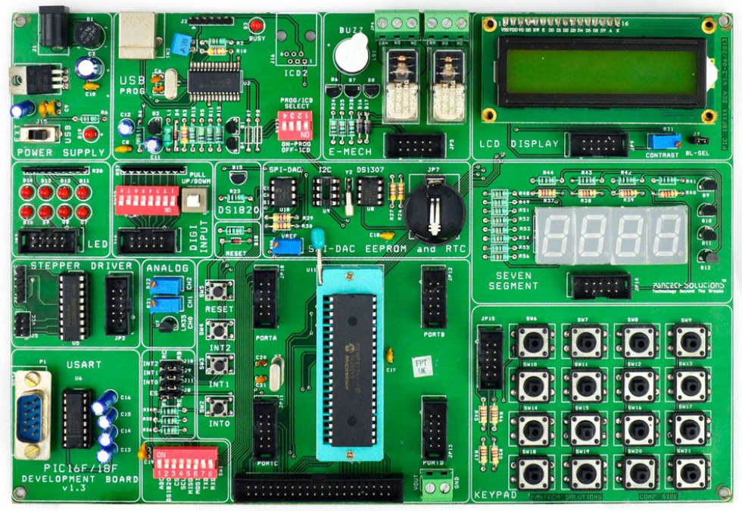
Embedded System Design using PIC
40pin-SIF Socket
8 Nos. Point LEDs (Logic Output)
8 Nos. Digital Input (DIP Switch)
4x4 Matrix Keypad
2X16 Character LCD (Background Light)
4 Nos. 7-Segment Display
2 Nos. Analog Input (Potentiometer)
Temperature Sensor (LM35)
Stepper Motor Interface
2 Nos. of SPST Relay
DS1307 RTC with Batter-Backup
USART(RS232)
USB 2.0 Enabled Programmer
Interrupts Study, Reset Button
SPI – EEPROM.25C040
I2C EEPROM 24C04
Digital Temperature Sensor(DS18S20)
4x10-Pin Expansion Connector
Piezo Electric Buzzer

Slide 5
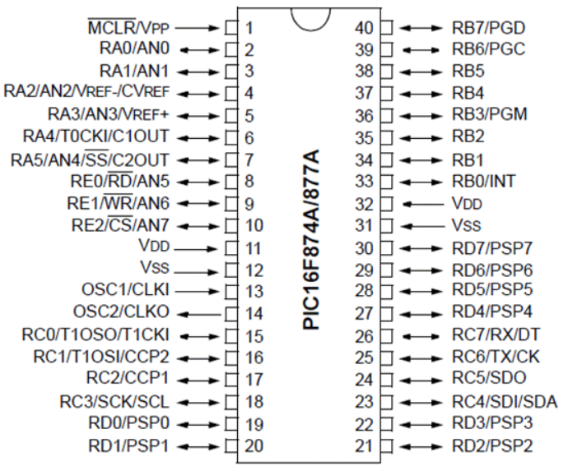
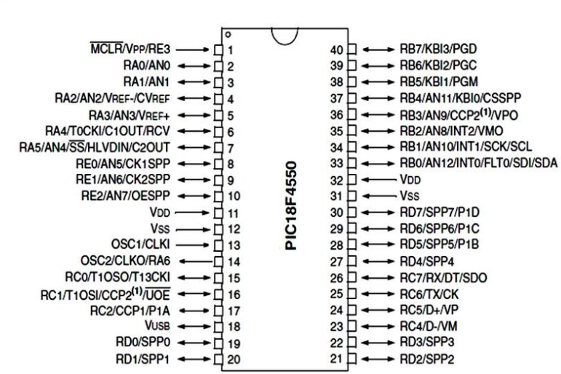
PIC PIN Diagram

Slide 6
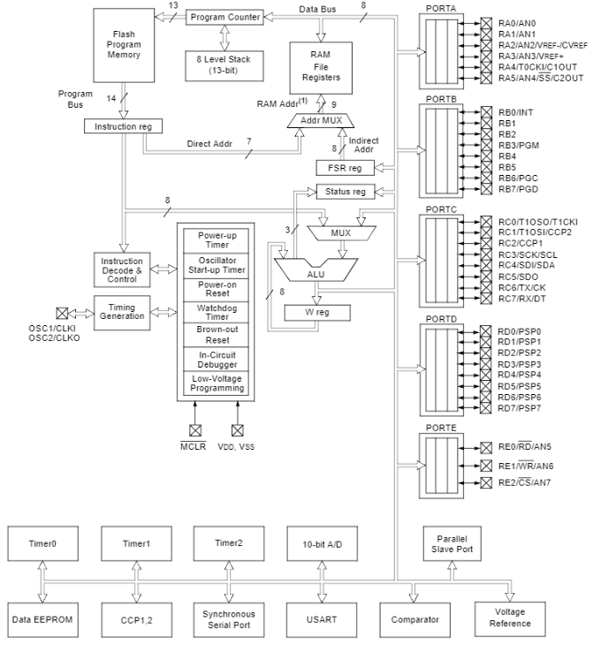
Block Diagram-Refer PIC16F877A Datasheet-Page 7

Slide 7
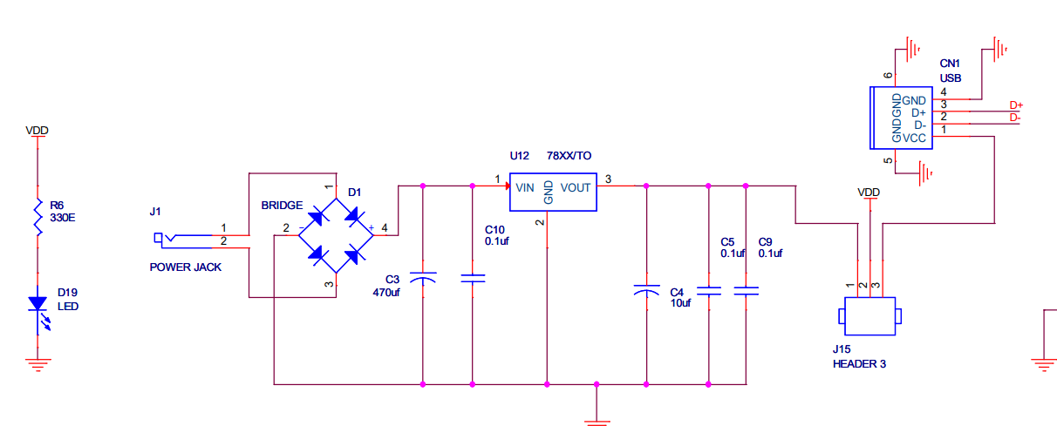
Power Supply

Slide 8
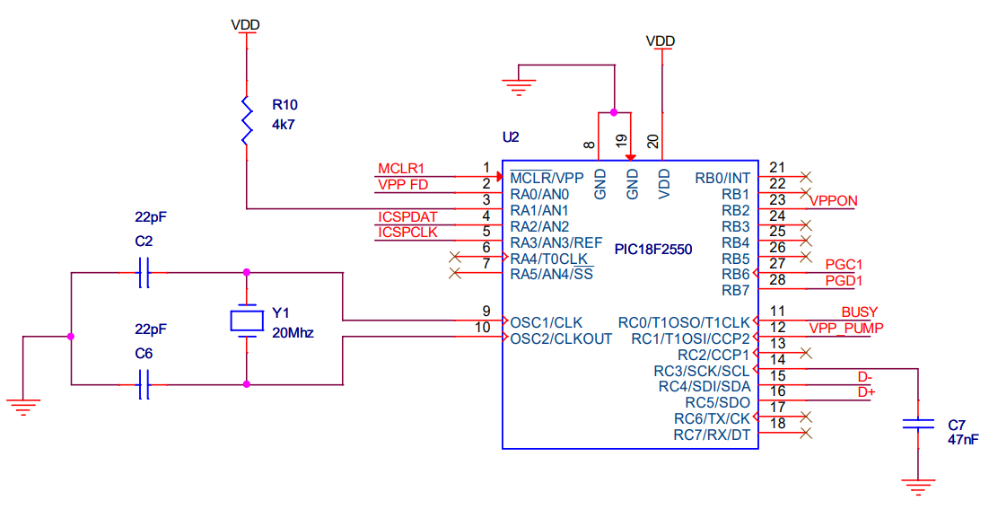
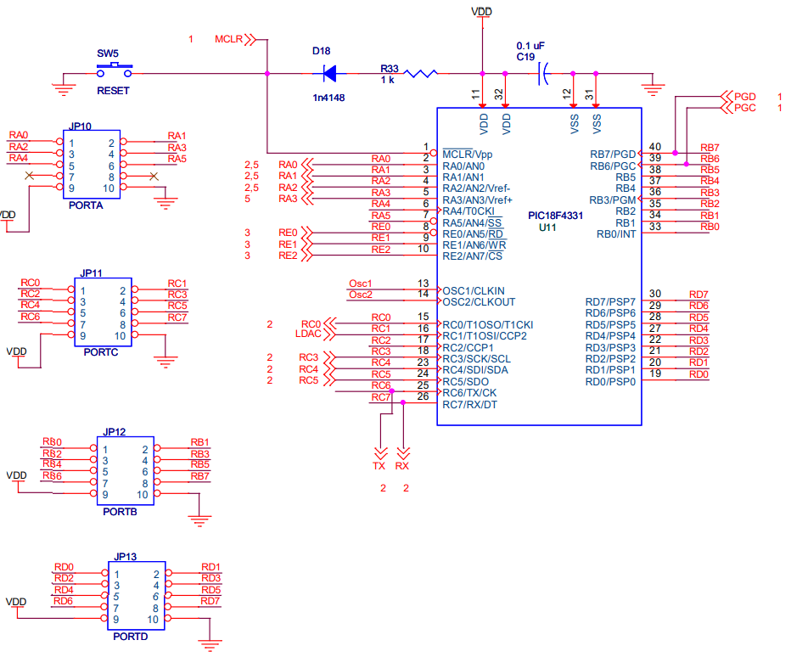
Oscillator

Slide 9
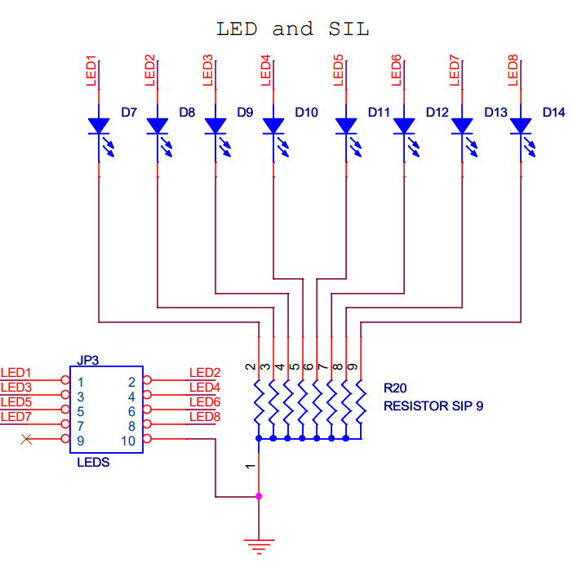
LED Interface

Slide 10
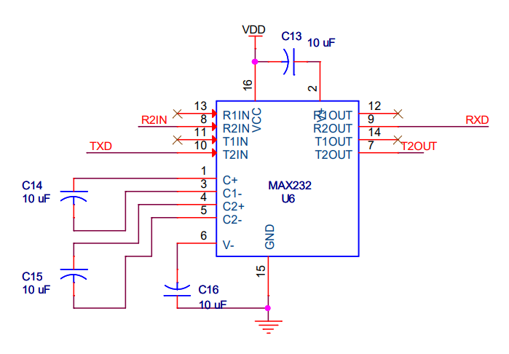
UART

Slide 11
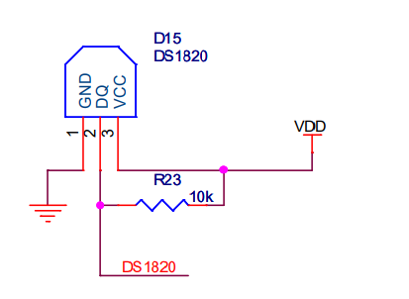
DS1820 –Temperature sensor Interface

Slide 12
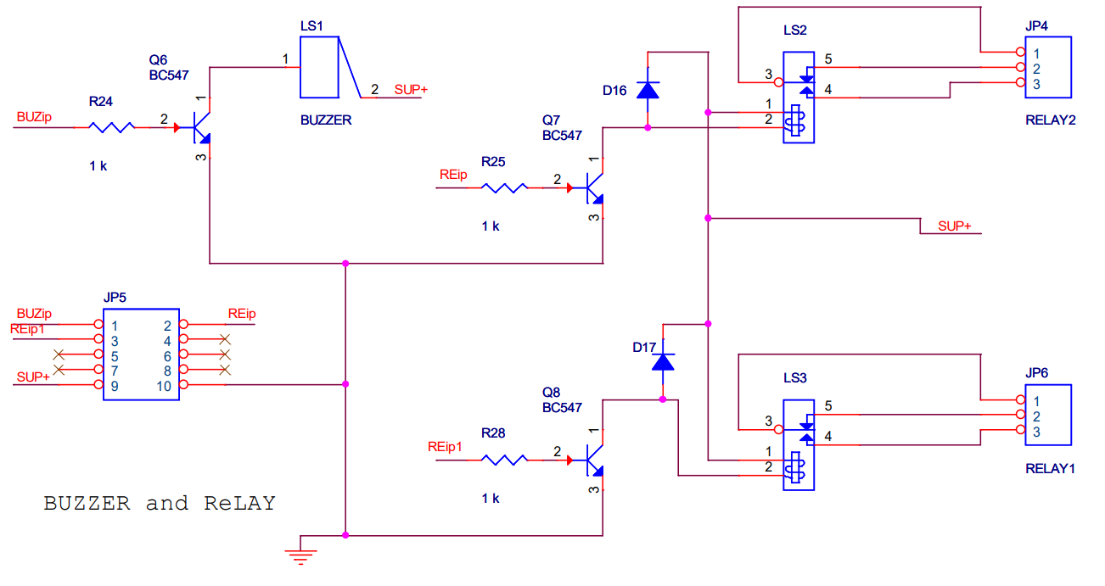
Buzzer and Relay

Slide 13
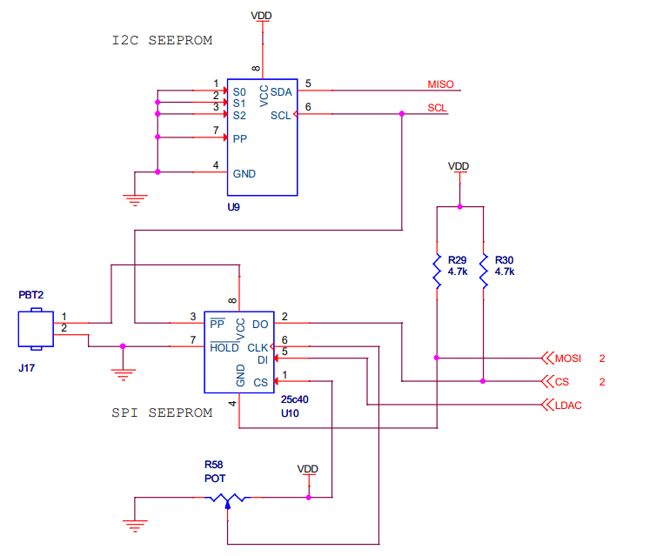
SPI and I2C EEPROM

Slide 14
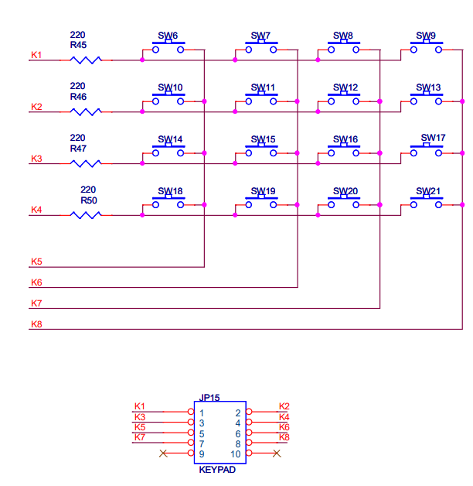
Keypad Interface

Slide 15
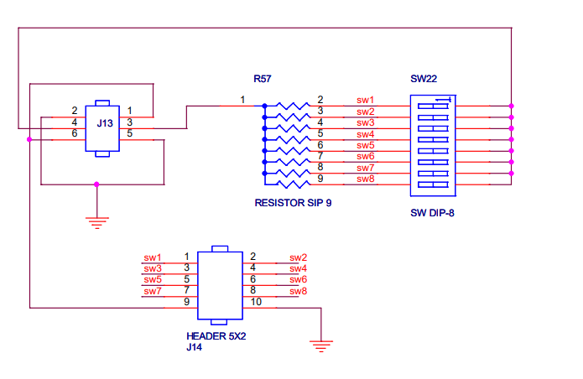
DIP SWITCH Interface

Slide 16
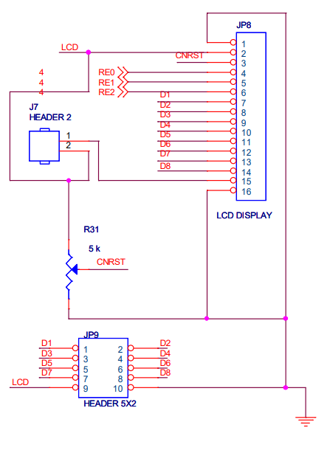
LCD Interface

Slide 17
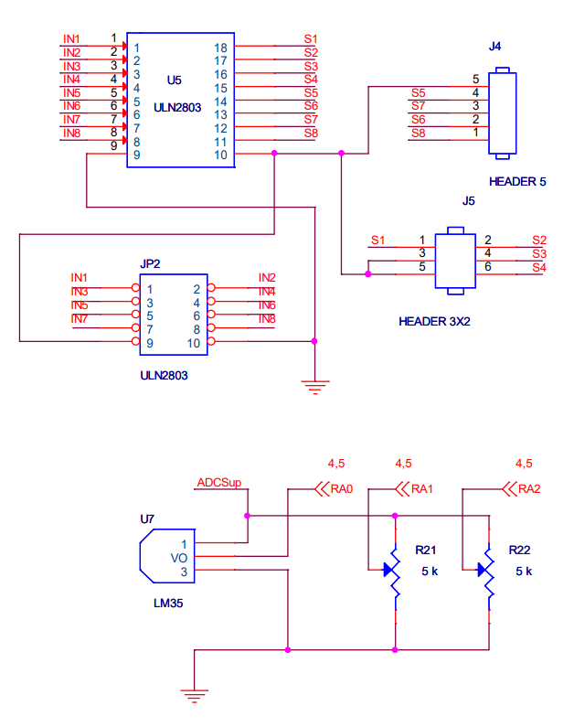
Stepper Motor Interface

Slide 18
Software to be Installed
MPLAB IDE 8.63

Slide 19
#include <pic.h> //Define PIC Registers
__CONFIG(0x3f72); //Select HS oscillator, Enable (PWRTE,BOREN), Turn OFF (CPD,CP,WDTEN,In-circuit Debugger).
void DelayMs(unsigned int);
void main()
{
TRISB = 0x00; //PORTB Configured as O/P
while(1)
{
PORTB = 0xff; //Enable all the LED's connected to PORTB
DelayMs(500); //Half second Delay
PORTB = 0; //Turn OFF all the LED's connected to PORTB
DelayMs(500); //Half second Delay
}
}
void DelayMs(unsigned int Ms)
{
int delay_cnst;
while(Ms>0)
{
Ms--;
for(delay_cnst = 0;delay_cnst <220;delay_cnst++);
}
}

Slide 20
Thank You

